Slide 1
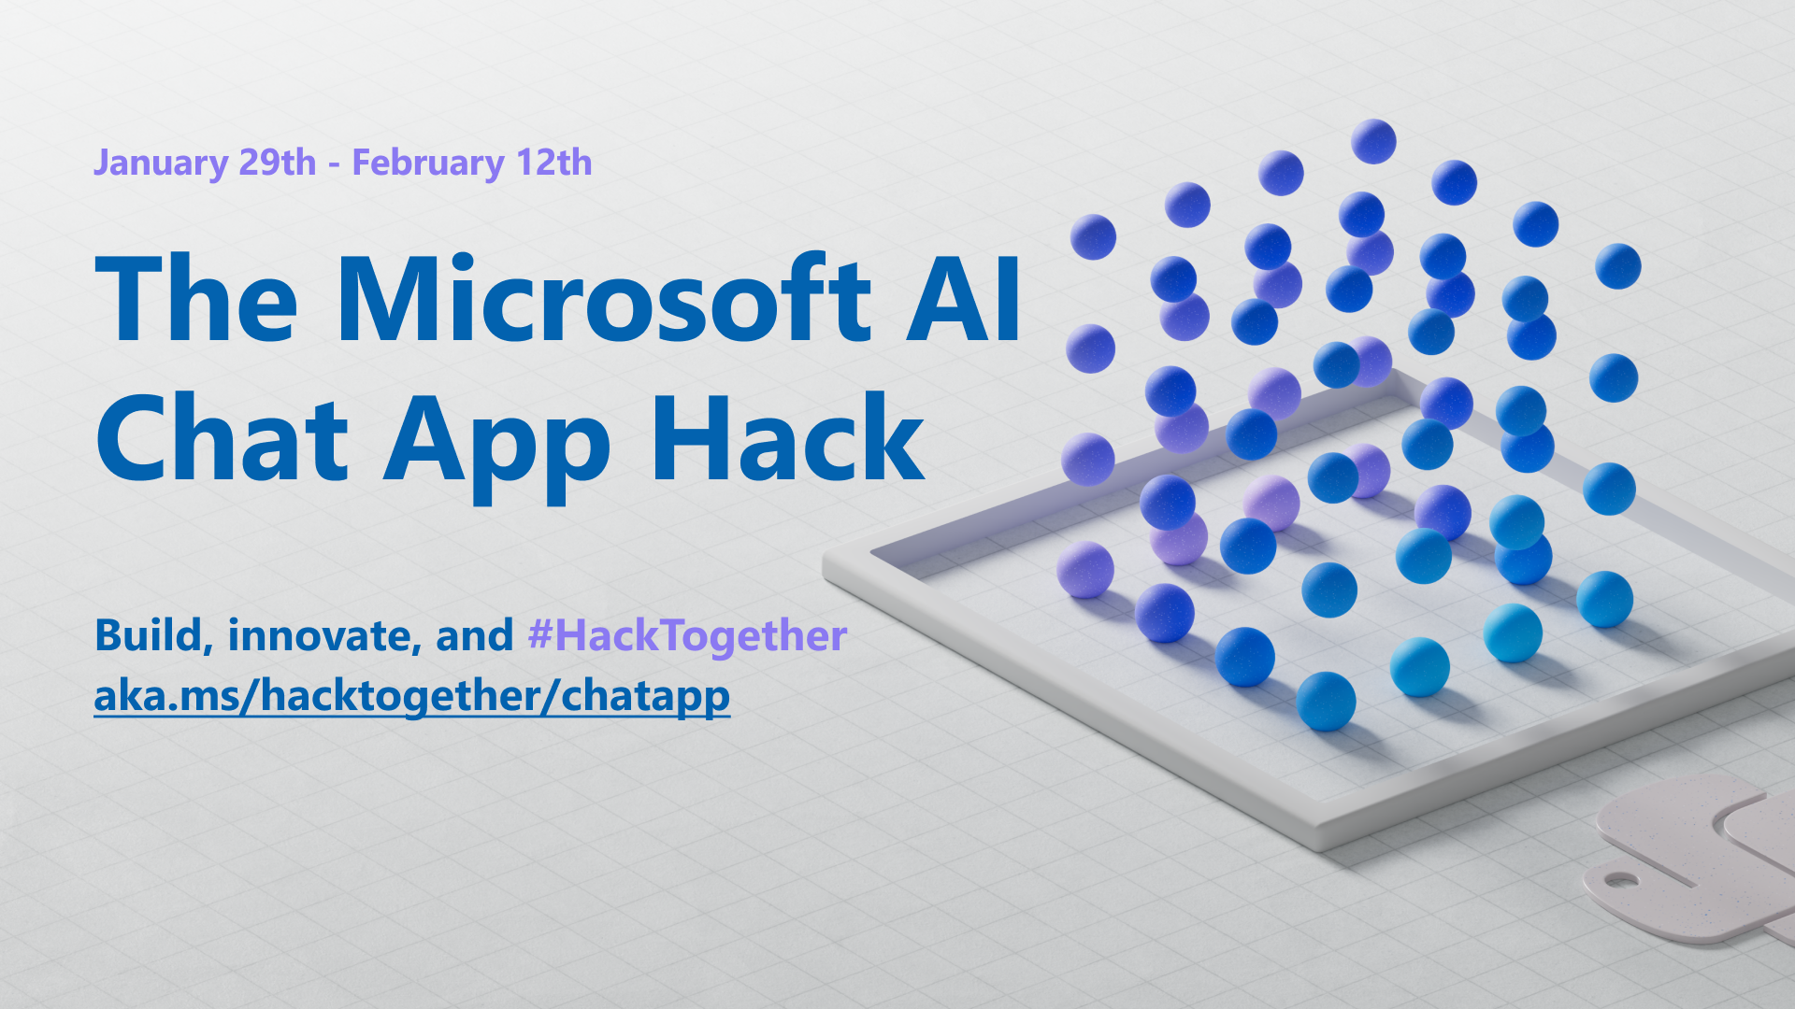

Slide 2
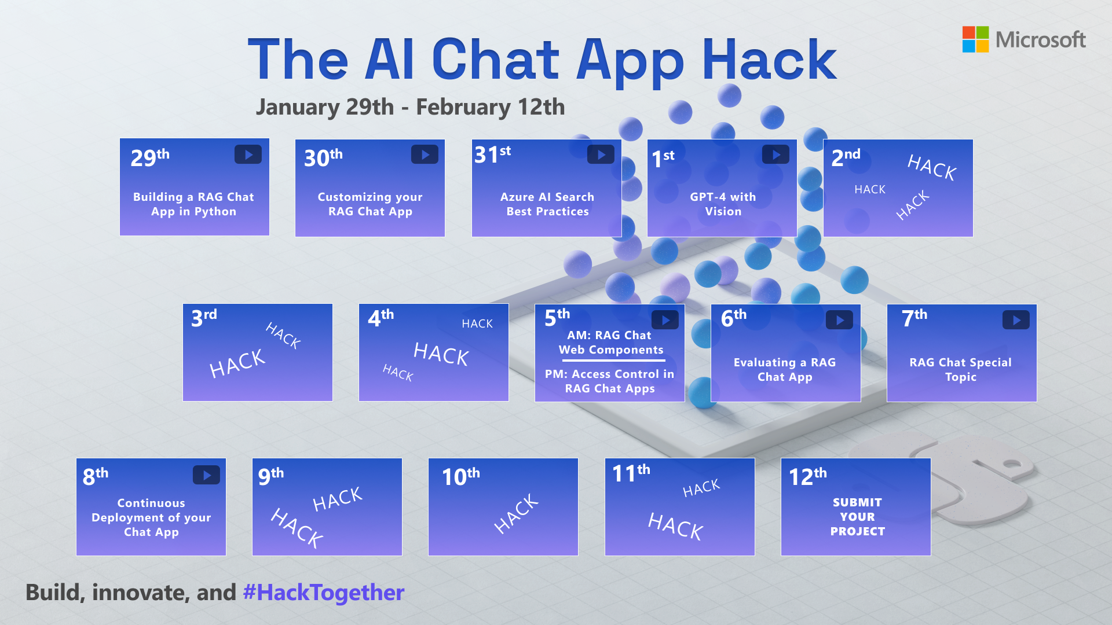

Slide 3

Azure AI Search Best Practices for RAG

Slide 4


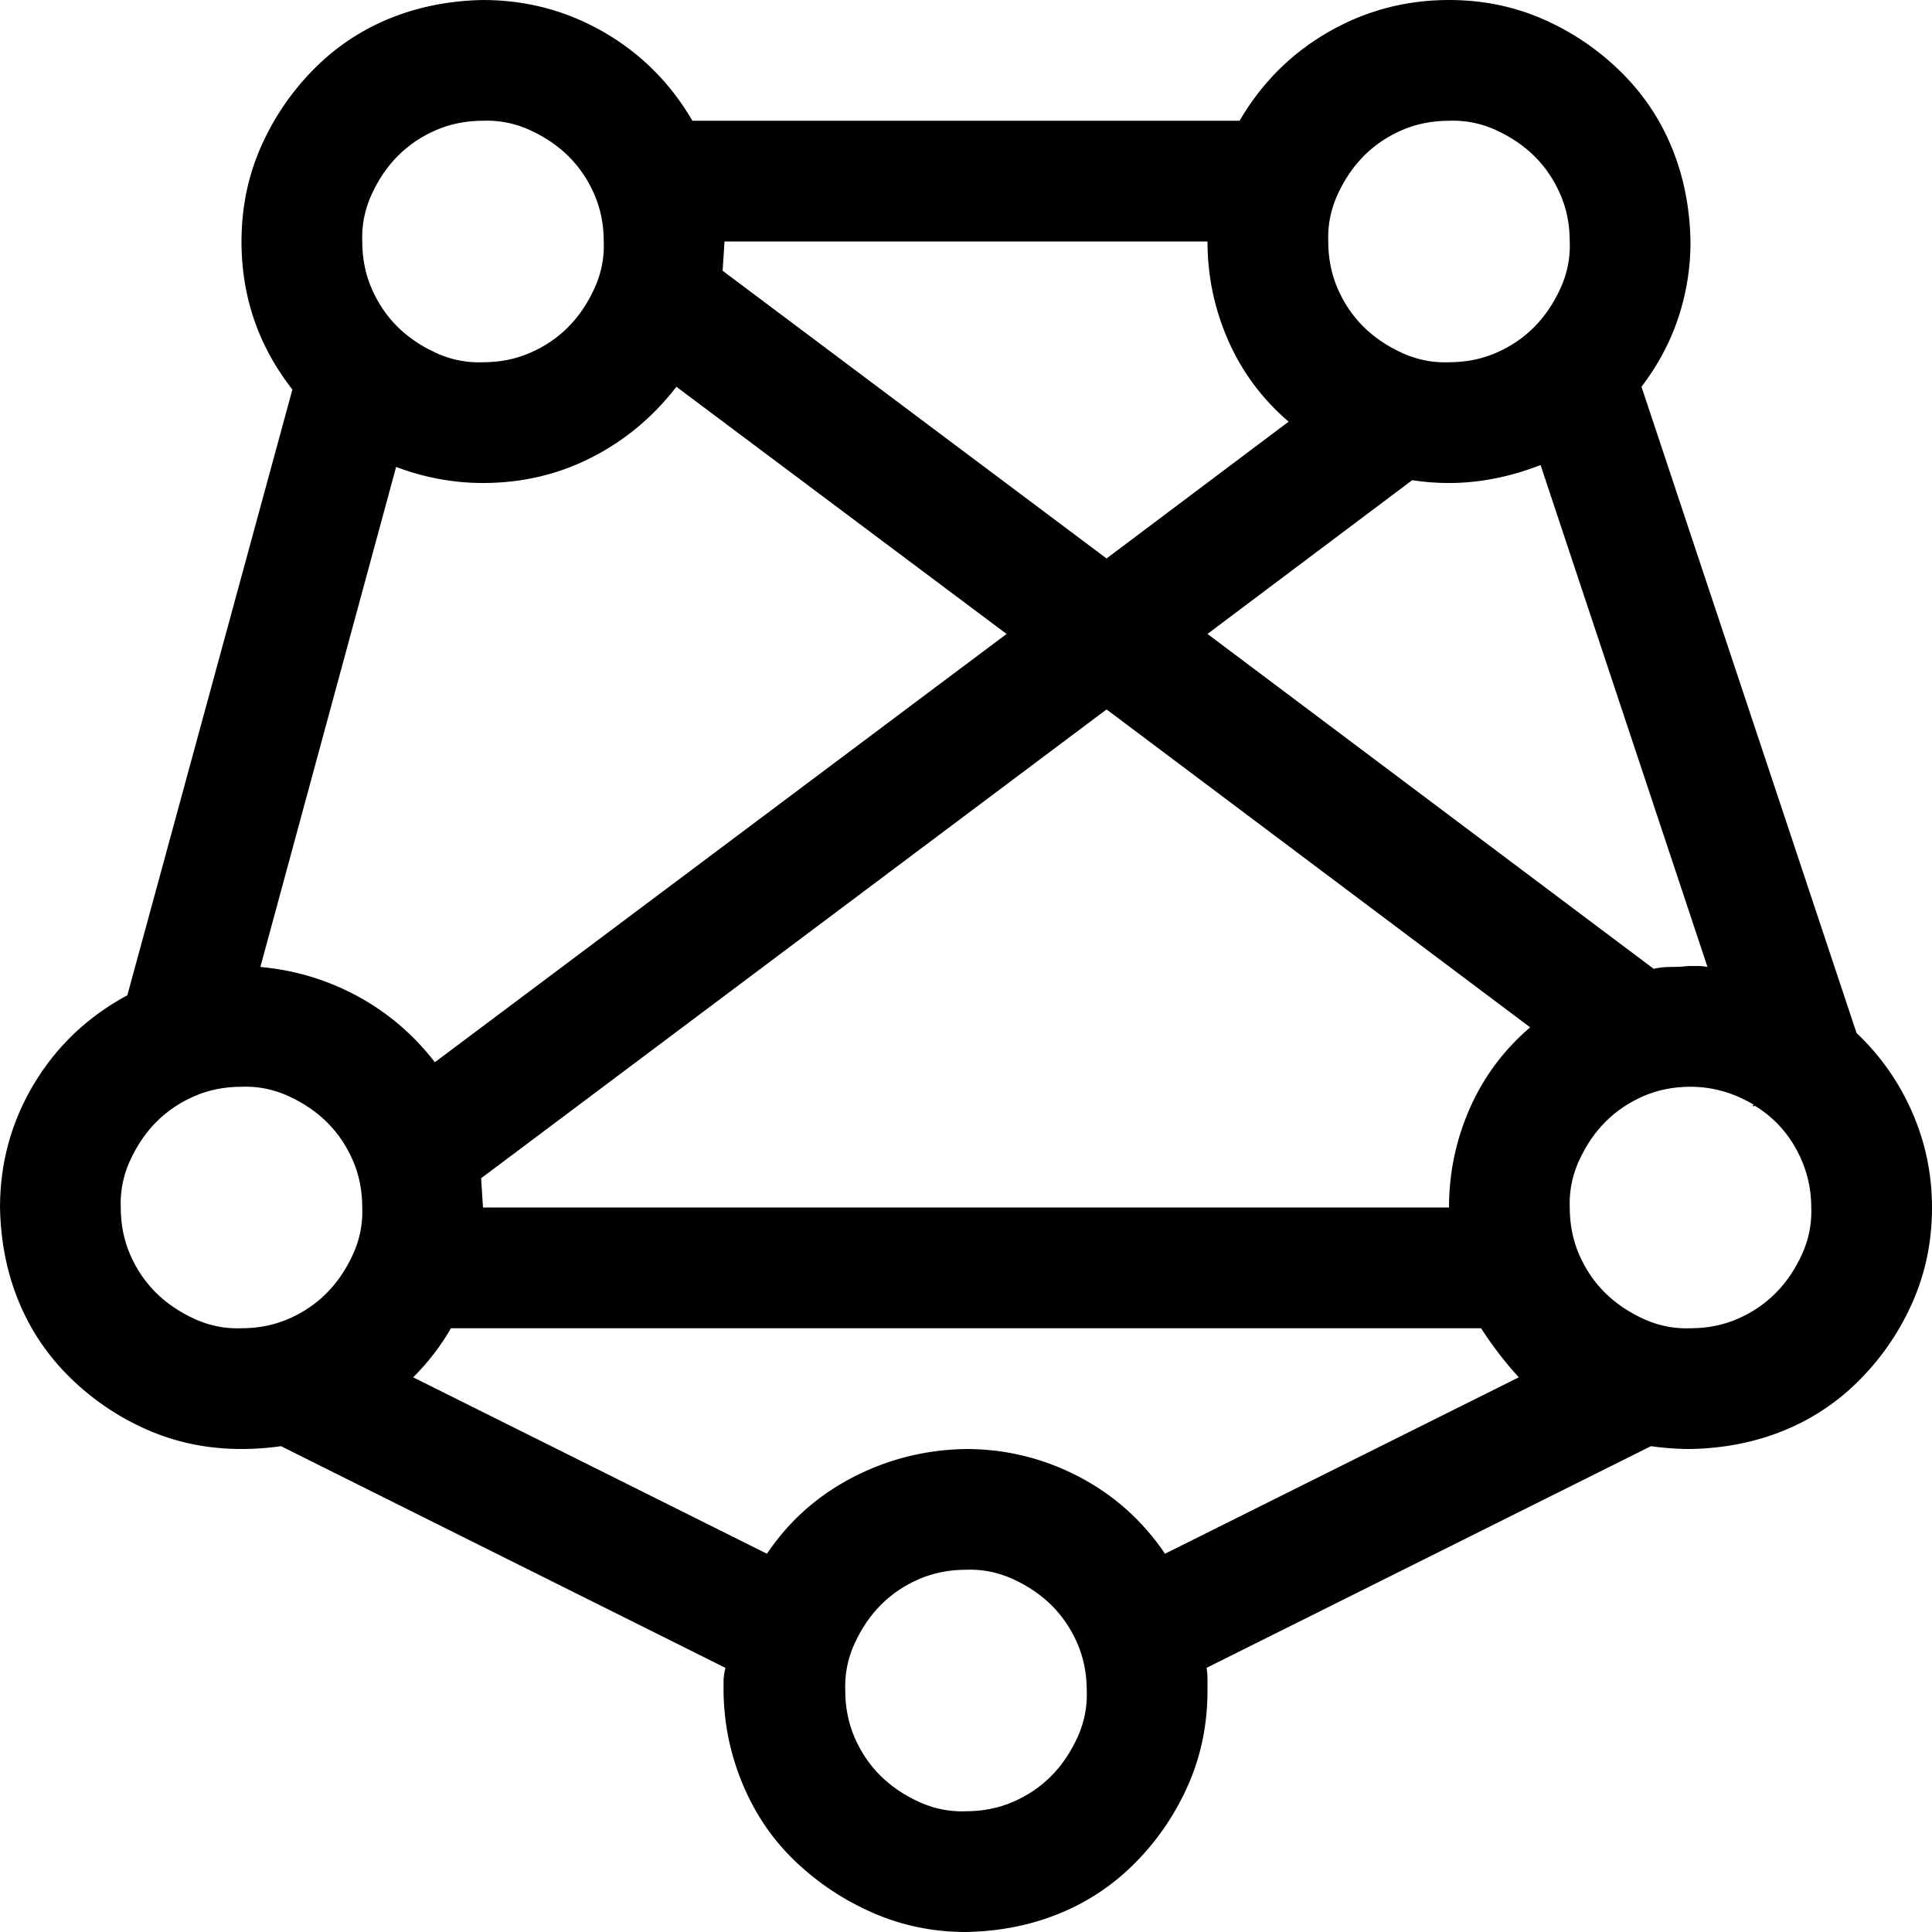

RAG: Retrieval Augmented Generation
Yes, your company perks cover underwater activities such as scuba diving lessons ¹
Do my company perks cover underwater activities?
PerksPlus.pdf#page=2: Some of the lessons covered under PerksPlus include: · Skiing and snowboarding lessons · Scuba diving lessons · Surfing lessons · Horseback riding lessons These lessons provide employees with the opportunity to try new things, challenge themselves, and improve their physical skills.….
User
Question
Document Search
Large Language Model

Slide 5
Robust retrieval for RAG chat apps
Relevance is critical for RAG apps
Lots of passages in prompt → degraded quality
→ Can’t only focus on recall
Incorrect passages in prompt → possibly well-grounded yet wrong answers
→ Helps to establish thresholds for “good enough” grounding data
Accuracy
Number of documents in input context
Source: Lost in the Middle: How Language Models Use Long Contexts, Liu et al. arXiv:2307.03172

Slide 6
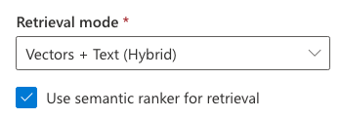
Optimal retrieval in Azure AI Search
Complete search stacks do better:
Hybrid retrieval (keywords + vectors) > pure-vector or keyword
Hybrid + Reranking > Hybrid
Reranking
Fusion (RRF)
Vector
Keywords

Slide 7
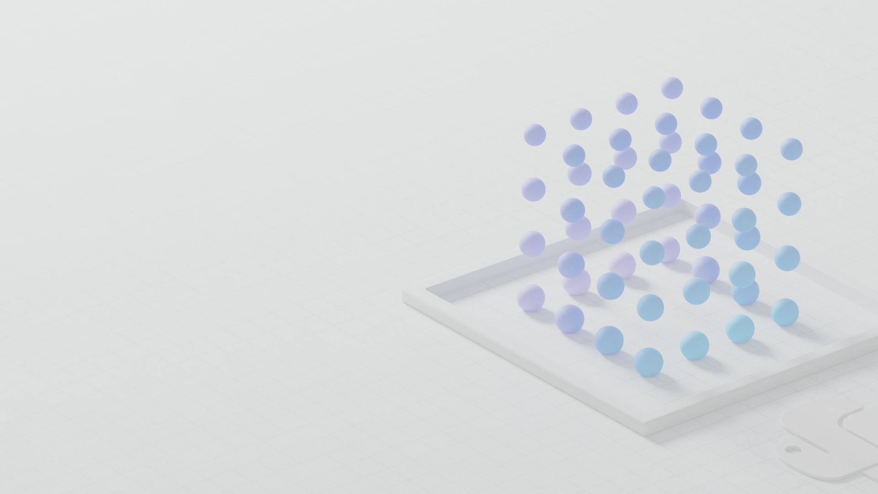
Vector search

Slide 8
Vector embeddings
An embedding encodes an input as a list of floating-point numbers.
”dog” → [0.017198, -0.007493, -0.057982, 0.054051, -0.028336, 0.019245,…]
Different models output different embeddings, with varying lengths.
Model | Encodes | Vector length
word2vec | words | 300
Sbert (Sentence-Transformers) | text (up to ~400 words) | 768
OpenAI ada-002 | text (up to 8191 tokens) | 1536
Azure Computer Vision | image or text | 1024
….and many more models!
🔗 Demo: Compute a vector with ada-002 (aka.ms/aitour/vectors)

Slide 9
Vector similarity
We compute embeddings so that we can calculate similarity between inputs.
The most common distance measurement is cosine similarity.
def cosine_sim(a, b):
return dot(a, b) /
(mag(a) * mag(b))
Similar:
θ near 0
cos(θ) near 1
Orthogonal:
θ near 90
cos(θ) near 0
Opposite:
θ near 180
cos(θ) near -1
*For ada-002, cos(θ) values range from 0.7-1
🔗 Demo: Compare vectors with cosine similarity (aka.ms/aitour/vectors)
🔗 Demo: Vector Embeddings Comparison (aka.ms/aitour/vector-similarity)

Slide 10
Vector search
Compute the embedding vector for the query
Find K closest vectors for the query vector
Search exhaustively or using approximations
Compute embedding vector
Search
existing vectors
K closest vectors
Query
Query vector
[[“snake”, [-0.122, ..],
[“frog”, [-0.045, ..]]]
OpenAI ada-002 create embedding
[-0.003335318, -0.0176891904,…]
Search
existing vectors
“tortoise”
💻 Demo: Search vectors with query vector (aka.ms/aitour/vectors)

Slide 11

Vector search in Azure AI Search
Generally available
Comprehensive vector search solution
Enterprise-ready
→ scalability, security and compliance
Integrated with Semantic Kernel, LangChain, LlamaIndex, Azure OpenAI Service, Azure AI Studio, and more
🔗 Demo: Azure AI search with vectors
(aka.ms/aitour/azure-search)

Slide 12
Vector search strategies
ANN search
Exhaustive KNN search
ANN = Approximate Nearest Neighbors
Fast vector search at scale
Uses HNSW, a graph method with excellent performance-recall profile
Fine control over index parameters
KNN = K Nearest Neighbors
Per-query or built into schema
Useful to create recall baselines
Scenarios with highly selective filters
e.g., dense multi-tenant apps
r = search_client.search(
None,
top=5,
vector_queries=[VectorizedQuery(
vector=search_vector,
k_nearest_neighbors=5,
fields="embedding")])
r = search_client.search(
None,
top=5,
vector_queries=[VectorizedQuery(
vector=search_vector,
k_nearest_neighbors=5,
fields="embedding",
exhaustive=True)])

Slide 13
Rich vector search query abilities
Filtered vector search
Scope to date ranges, categories, geographic distances, access control groups, etc.
Rich filter expressions
Pre-/post-filtering
Pre-filter: great for selective filters, no recall disruption
Post-filter: better for low-selectivity filters, but watch for empty results
r = search_client.search(
None,
top=5,
vector_queries=[VectorizedQuery(
vector=query_vector,
k_nearest_neighbors=5,
fields="embedding")],
vector_filter_mode=VectorFilterMode.PRE_FILTER,
filter=
"tag eq 'perks' and created gt 2023-11-15T00:00:00Z")
🔗 Filters in vector queries (aka.ms/aisearch/vectorfilters)
Multi-vector scenarios
Multiple vector fields per document
Multi-vector queries
Can mix and match as needed
r = search_client.search(
None,
top=5,
vector_queries=[
VectorizedQuery(
vector=query1, fields="body_vector",
k_nearest_neighbors=5,),
VectorizedQuery(
vector=query2, fields="title_vector",
k_nearest_neighbors=5,)
])

Slide 14
Hybrid search

Slide 15
Optimal retrieval in Azure AI Search
Complete search stacks do better:
Hybrid retrieval (keywords + vectors) > pure-vector or keyword
Hybrid + Reranking > Hybrid
Reranking
Fusion (RRF)
Identify good & bad candidates
Normalized scores from semantic ranker
Exclude documents below a threshold
Vector
Keywords
🔗 Demo: Compare text, vector, hybrid, reranker (aka.ms/aitour/search-relevance)

Slide 16
Retrieval relevance across methods
🔗 Outperforming vector search with hybrid + reranking (aka.ms/ragrelevance)

Slide 17
Impact of query types on relevance
Query type | Keyword [NDCG@3] | Vector [NDCG@3] | Hybrid [NDCG@3] | Hybrid + Semantic ranker [NDCG@3]
Concept seeking queries | 39 | 45.8 | 46.3 | 59.6
Fact seeking queries | 37.8 | 49 | 49.1 | 63.4
Exact snippet search | 51.1 | 41.5 | 51 | 60.8
Web search-like queries | 41.8 | 46.3 | 50 | 58.9
Keyword queries | 79.2 | 11.7 | 61 | 66.9
Low query/doc term overlap | 23 | 36.1 | 35.9 | 49.1
Queries with misspellings | 28.8 | 39.1 | 40.6 | 54.6
Long queries | 42.7 | 41.6 | 48.1 | 59.4
Medium queries | 38.1 | 44.7 | 46.7 | 59.9
Short queries | 53.1 | 38.8 | 53 | 63.9
🔗 Outperforming vector search with hybrid + reranking (aka.ms/ragrelevance)

Slide 18
Azure AI search
data indexing

Slide 19




Manual indexing
You can use the SDK to write your own code to add data to an index.
Azure Storage
Document
Intelligence
Python
Azure OpenAI
Azure
AI Search
Example:
prepdocs.py
Stores PDFs
Extracts data from PDFs
Splits data
into chunks
Computes embeddings
Stores in index
🔗 Data ingestion guide: Adding documents aka.ms/ragchat/add-data
Notes:
Demo!

Slide 20
Cloud-based indexing
Indexers: Connect the search service to a cloud data source, and it will index the data periodically or on a trigger.
Data source
Indexer
Target Index
Azure Blob Storage
Azure Cosmos DB
Azure Data Lake Storage Gen2
Azure SQL Database
SharePoint in Microsoft 365
Azure Cosmos DB for MongoDB
…and more!
🔗 Indexers in Azure AI Search (aka.ms/aisearch/indexers)
Notes:
Demo!

Slide 21
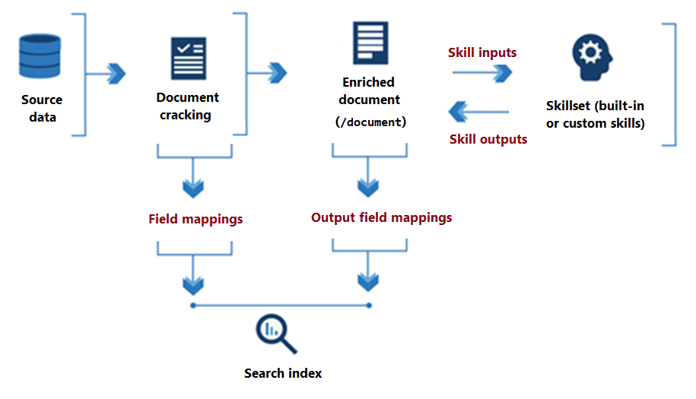
Skillsets for indexers
Skillset: A set of skills that prepare a document for indexing, calling either built-in AI search functions or custom code.
🔗 Skillset concepts in Azure AI Search (aka.ms/aisearch/skillsets)
Notes:
Demo!

Slide 22
Integrated vectorization
In preview
A combination of indexers and built-in skills for chunking and vectorization.
Data source access
Blob Storage
ADLSv2
SQL DB
CosmosDB
…
Incremental change tracking
File format cracking
PDFs
Office documents
JSON files
…
Extract images and text, OCR as needed
Chunking
Split text into passages
Propagate document metadata
Vectorization
Turn chunks into vectors
OpenAI embeddings or your custom model
Indexing
Document index
Chunk index
Both
🔗 Integrated data chunking and embedding in Azure AI Search (aka.ms/integrated-vectorization)
Notes:
Guest speaker Chris Ayers

Slide 23
Integrated vectorization in RAG chat repo
Once the PR is merged, you can opt to use it via:
azd env set USE_FEATURE_INT_VECTORIZATION true
azd up
🔗 PR: Adding integrated vectorization support (aka.ms/ragchat/intvect)
Notes:
Demo!

Slide 24
Manual indexing vs. Integrated vectorization
Pros:
All code is local and easy to change.
Cons:
Hard to connect to indexers for cloud-based data.
Has to be manually re-run for new data.
Pros:
Easily connect to indexers that can add new data on triggers or periodically.
You don’t need to maintain chunking or embedding code yourself.
Cons:
Currently in preview mode.
Customizing the skills takes more effort, if the built-in skills are not sufficient.
Notes:
Demo!

Slide 25
Azure AI search
advanced features

Slide 26
Analyzers
Analyzers are components of the full-text search engine for processing strings during indexing and query execution.
Language analyzers: If you’re indexing non-English documents in particular, consider customizing the analyzer used.
Custom analyzers: Useful for custom tokenization, like to recognize phone numbers, word normalization, etc.
🔗 Analyzers for text processing in Azure AI Search (aka.ms/aisearch/analyzers)
Notes:
Demo!

Slide 27
Scoring profiles
Scoring profiles are criteria for boosting a search score based on custom parameters.
"scoringProfiles": [
{
"name": "boostKeywords",
"text": {
"weights": {
"HotelName": 2,
"Description": 5 }
}
}
]
🔗 Add scoring profiles to boost search scores (aka.ms/aisearch/scoring)
Notes:
Demo!

Slide 28
Next steps
Register for the hackathon →
Introduce yourself in our discussion forum
Deploy the repo with the sample data
See steps on low cost deployment →
Start customizing the project!
Post in forum if you have any issues deploying or questions about customization. 🙋🏼 🙋🏾‍♀️ 🙋🏻 🙋🏼‍♀️ 🙋🏿‍♂️
Join tomorrow’s session: GPT-4 with Vision
aka.ms/hacktogether/chatapp
aka.ms/ragchat/free

